Slide 1

Industrial/Organizational Psychology: An Applied Approach, 9e
Chapter 4: Employee Selection: Recruiting and Interviewing
Michael G. Aamodt, Industrial/Organizational Psychology: An Applied Approach, 9th Edition. © 2023 Cengage. All Rights Reserved. May not be scanned, copied or duplicated, or posted to a publicly accessible website, in whole or in part.

Slide 2
Icebreaker
What are some ways you have seen organizations attempt to recruit new employees?

Slide 3
Learning Objectives
04-01 Know how to recruit applicants
04-02 Explain why the traditional, unstructured interview doesn’t work
04-03 Construct a valid, structured interview
04-04 Perform well when being interviewed
04-05 Write a resume and a cover letter

Slide 4
Employee Recruitment

Slide 5
External and Internal Recruitment Methods
External recruitment
Internal recruitment
Competitive
Noncompetitive

Slide 6
Recruitment Methods: Ads, Agencies, and Recruiters
Media advertisements
Newspaper ads
Electronic media
Point of purchase
Recruiters
Campus recruiters
Outside recruiters
Employment agencies and search firms
Employment agencies
Executive search firms
Public employment agencies
Employee referrals
Direct mail

Slide 7

Recruitment Methods: Online and In Person
Internet
Employer-based websites
Job boards
Social media
Job marketplaces
Job fairs

Slide 8
Media Ads—Only 2.3% Are External Hires from Print Media
Newspaper
Electronic media

Slide 9
Writing Recruitment Ads
Realistic information
Detailed description of the job and organization
Selection process information

Slide 10
Workbook Exercise 4.1

Slide 11
Electronic Media
TV ads
Radio ads
Targeted audience

Slide 12
Point of Purchase Methods
Store windows
Bulletin boards
Restaurant placemats
Side of trucks
Receipts
Inexpensive and targeted
Limited exposure

Slide 13
Workbook Exercise 4.2

Slide 14
Recruiters
Recruiters
Campus recruiters
Outside recruiters
Employment Agencies and Search Firms
Employment agencies
Executive search firms
Public employment agencies

Slide 15
Workbook Exercise 4.3

Slide 16
Employee Referrals
Private sector (Silkroad, 2017, 2018)
78% use employee referrals
Excellent recruitment source

Slide 17
Incentive for Referral
Amount of incentive
Between $1,000 and $2,500
Length of referred employee tenure before eligible for referral incentive
Average of 3 months
24% reported making a referral for the incentive

Slide 18
Employee Referral Considerations
Only successful employee referrals
Friends tend to be the same gender, race, and national origin (less diverse)

Slide 19
Direct Mail Recruiting
Types
E-mail
Mail
Bank statements (Bank of America)
Passive applicants

Slide 20
Direct Mail Success Stories
Allstate Insurance
Mailed out 64,000 letters
Received 500 responses
Hired 20 nurses
Union Special
Illinois manufacturer of sewing machines
Had 10 openings for engineers
Sent 3,300 cards to Chicago area engineers ($5,000)
Received 100 responses
Interviewed 30 applicants

Slide 21
Internet Recruiting
Four common Internet methods
Employer-based websites
Normal website
Company blogs
YouTube
Job boards (leading recruitment websites in 2020)
indeed
Glassdoor
monster
LinkedIn

Slide 22
Internet Recruiting cont.
Social media
Facebook, Twitter, & LinkedIn
Blogs
Podcasts
Job Marketplaces
Glassdoor

Slide 23
Job Fairs
Multiemployer job fair
May be college or Chamber of Commerce events
Event or disaster affects local employment
Many organizations in the same field (e.g., education)
Organization job fair

Slide 24
Special Populations
Historically Black colleges and universities (HBCUs)
Targeted intern positions
Highlighting organization’s openness to diversity in recruitment materials

Slide 25
Nontraditional Sources
Chicago Police Department formed partnerships with local churches
IBM and Google developed recruitment strategies and such LGBTQIA+ supportive benefits as domestic partner benefits
Jefferson County, Alabama sponsored a job fair for individuals previously incarcerated
Trucking companies hiring married couples

Slide 26
Recruiting “Passive” Applicants
Build relationships with professional associations
SIOP, SHRM

Slide 27
Evaluating Recruitment Strategy Effectiveness
Number of applicants
Cost per applicant
Cost per qualified applicant
Number of individuals from underrepresented groups and women applicants

Slide 28
Visualization: Evaluating Recruitment Effectiveness
Criterion | Recruitment Sources: Advertisements | Recruitment Sources: Referrals | Recruitment Sources: Walk-ins
Number of applicants | 40 | 30 | 10
Number qualified | 10 | 15 | 5
Number hired | 2 | 7 | 1
Number successful | 0 | 4 | 1

Slide 29
Why Inside Sources Are Superior
Several theories:
Realistic job preview
Different recruitment sources reaching different types of applicants
Interpersonal attraction

Slide 30
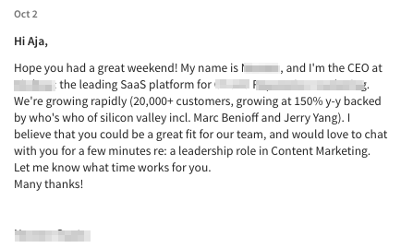

Activity: Discussion of Recruitment Methods
What are the most effective recruitment methods you have seen?

Slide 31
Realistic Job Previews

Slide 32
Realistic Job Preview (RJP)
Honest assessment of a job
Informed applicants lead to longer tenure
Honest communication from organization
Expectation-lowering procedure (ELP)

Slide 33
Top Things to consider
Employee Value Proposition
Total reward offer
Salary, bonus, benefits
Company Brand
Can impact who you recruit/effort needed
Measure Success Rates/ROI
LinkedIn
Indeed
Glassdoor

Slide 34
Effective Employee Selection Techniques

Slide 35
Characteristics of Effective Employee Selection Techniques
Share three characteristics:
Valid
Content validity
Criterion validity
Construct validity
Reduce the chance of legal challenge
Face validity
Privacy
Adverse impact
Cost-effective

Slide 36
Employment Interviews

Slide 37
Interviews Differ in Three Ways
Structure
Unstructured
Structured
Style
One-on-one
Serial
Return
Panel
Group
Medium
Face-to-face
Telephone
Videoconference
Written

Slide 38
Structured Interviews Advantages
Job relatedness
Standardized scoring
Incremental validity
Viewed more favorably in courts than unstructured interviews

Slide 39
Unstructured Interviews Are Not Optimal
They are:
Unreliable
Not valid
Legally problematic
Because they:
Are not job related
Rely on intuition, “amateur psychology,” and talk show methods

Slide 40
Unstructured Interviews Are Not Optimal cont.
Because they:
Suffer from common rating problems
Primacy effects
Contrast effects
Negative-information bias
Interviewer-interviewee similarity
Interviewee appearance
Nonverbal cues

Slide 41
Common Unstructured Interview Questions
Why should I hire you?
Where do you see yourself five years from now?
What are your greatest strengths?
What are your greatest weaknesses?
What subject did you most enjoy in college?
How would you describe yourself?
Why are you interested in this job?

Slide 42
Activity: Top Ten Stupid Interview Tricks (1 of 2)
A manager at Wells Fargo won’t hire MBAs who take more than 60 seconds to scan the menu at lunch
A CEO wouldn’t hire applicants who salted their food before tasting it
Holiday Inn doesn’t hire applicants who smile less than four times during the interview
An HR professional wouldn’t hire applicants who didn’t have the back of their shoes properly shined
An auto insurance executive takes off points for education: “I don’t want the valedictorian, I want the kid who sold cigarettes in the bathroom.”

Slide 43
Activity: Top Ten Stupid Interview Tricks (2 of 2)
An HR manager asked applicants about their favorite book
A town manager likes to leave the room, not come back, and then wait to see how long an applicant will wait
An HR recruiter asks applicants, “If you could be any animal, what would you be?”
A local school superintendent won’t hire men with hair in their ears
Any interviewer who does not use structured interviews!

Slide 44
Activity: Discussion of Interviews
What interview horror stories have you heard about (or experienced yourself)?

Slide 45
Structured Interviews Are Optimal
They are:
Reliable
Valid
Not as prone to legal challenge
Because they:
Are based on a job analysis
Ask the same questions of each applicant
Have a standardized scoring procedure

Slide 46
Creating the Structured Interview
Determine the KSAOs to tap in the interview
Create interview questions
Create a scoring key for interview answers

Slide 47
Determining the KSAOs to Tap
Thorough job analysis:
Tasks performed
Conditions under which they are performed
KSAOs needed to perform the tasks
When KSAOs are needed
Before hire
After hire

Slide 48
Workbook Exercise 4.4

Slide 49
Creating Interview Questions
Six types of interview questions:
Clarifiers
Disqualifiers
Skill-level determiners
Future-focused questions/situational questions
Past-focused questions/patterned-behavior description interviews (PBDIs)
Organizational-fit questions

Slide 50
Workbook Exercise 4.5

Slide 51
Examples of Clarifiers
I noticed that you do not have an education section on your resume, could you tell me about your educational background?
I noticed a three-year gap between two of your jobs, could you tell me a little about that?
You were a bench hand at AT&T. What is that?
Why did you leave your job at McDonald’s?

Slide 52
Examples of Disqualifiers
Can you work at least one weekend a month?
Can you work overtime without notice?
Would you be willing to treat a patient with AIDS?
Do you have a valid driver’s license?

Slide 53
Examples of Past-Focused Questions
When dealing with customers, it is inevitable that you will encounter an angry customer. Tell us about a time when a customer was angry at you. What did you do in that situation?
The job of network engineer requires a good deal of customer service. Tell us about your customer service experience.
This job involves persuading employees to follow our safety rules. Tell us about a time in the past when you had to persuade an employee to do something.

Slide 54
Examples of Skill Determiners
A customer brings you their checkbook and says that they cannot get it to balance. What are they probably doing wrong? How would you explain the error to them?
A client calls and tells you that they have 10 computers in a 30’ by 100’ room and that they want to network the computers. What questions would you ask? What parts would you need to compile to complete the task?
Several months after installing the above network, the client calls and says that nothing will print on the printer. What could be going on?

Slide 55
Examples of Future-Focused Questions
Suppose that you were scheduled to work on Saturday. A friend calls on Thursday and says that you get to use a condo at the beach for free—but it has to be this weekend. What would you do?
Imagine that you told a client that you would be there at 10:00 a.m. It is now 10:30 and there is no way you will be finished with your current job until 11:30. You are scheduled to meet another client for lunch at 12:00 and then be at another job at 1:15. How would you handle the situation?

Slide 56
Examples of Organizational-Fit Questions
Under what type of supervisor do you work best? Is there a type of supervisor for which you have trouble working?
What type of work pace is best for you?
Describe your sense of humor.
Describe your experience working with a culturally diverse group of people.

Slide 57
Creating a Scoring Key for Interview Answers
Right/Wrong Approach
Typical Answer Approach
Benchmark answers
Key Issues Approach

Slide 58
Workbook Exercise 4.6

Slide 59
Sample Question
You are working as a teller and have a long line of waiting customers. A customer runs to the front of the line and yells that they bounced a check and were charged $20, which caused other checks to bounce. They then swear at you and tell you that they will not leave until the problem is solved. You are unable to check on the account because the computer is down. What would you do?

Slide 60
Typical Answers Scoring
Because I do not have the information and the line is long, I would call my supervisor and have them talk to the customer in an office away from everyone else
While trying to calm them down, I would call my supervisor
I would try to calm them down and explain that the computer is down
I would explain that I cannot help because the computer is down, and ask them to come back later
I would tell them to get to the end of the line and wait their turn
I would ignore them until they went away

Slide 61
Key Issues Scoring
___ Acknowledged the long line and concern for other customers
___ Recognized the need to calm the customer
___ Recognized the need to get the customer away from the other customers
___ Recognized that help could not be immediately given because the computer was down
___ Was not confrontational with the customer

Slide 62
Conducting the Structured Interview
Build rapport
Explain the process and the agenda
Ask the questions
Score the answer and take notes after each question
Provide information about the job and the organization (e.g., salary, benefits, climate)
Answer interviewee’s questions
End the interview on a pleasant note

Slide 63
Job Search Skills
Notes:
Resumes and Cover Letters

Slide 64
Surviving the Interview Process
Scheduling the interview
Before the interview
During the interview
After the interview

Slide 65
Workbook Exercise 4.8

Slide 66
Writing Cover Letters
Salutation
Name
Paragraphs
Resume, name of job, how you know about the job
Your qualifications
Why you are interested in the company
Information on how you can best be reached
Signature
“Cordially”
“Sincerely”

Slide 67
General Points
Keep to one page
Don’t beg
Avoid sounding desperate
Avoid grammar and spelling errors
No officious words or phrases
No personal circumstances
Avoid curse words and insults
Don’t rehash your resume
Don’t bad mouth your former employer
Tailor your letter to each company
Direct to a particular person

Slide 68
Cover Letter Example
April 18, 2015
Mr. John Smith
Alco, Inc.
217 West Street
Johnson, VA 24132
Dear Mr. Smith:
Enclosed find a copy of my resume. Please consider me for the position of welder that was advertised in the Roanoke Times and World News.
I believe I am qualified for your position. I have six years of welding experience in an industrial setting. Furthermore, I am a very dependable worker as shown by the fact that I have only missed two days of work in the last five years. Finally, I am available to work any shift at any of your three plants.
I look forward to hearing from you. I can best be reached after 3:00 p.m. on weekdays and anytime on weekends.
Sincerely,
Andrew S. Jones

Slide 69
Cover Letters that Were Never Read
I call you that because I feel I’ve known you for years.
As Rod McKuen said so beautifully….
I would like to aply for the position of editoral asistent
I have always dreamed of being a writer.
My mother told me I should …
FLASH! Judy Carson is coming to Nashville and …
The Bible tells us “Seek and ye shall find.” So I am seeking ….

Slide 70
Writing a Resume
Summaries of professional and educational background

Slide 71
Characteristics of Effective Resumes
Attractive and easy to read
white space
Font
Does not contain typing, spelling, or factual mistakes
Makes the applicant look as good as possible

Slide 72
Psychological Principles of Impression Formation
Primacy
Priming
Short-term memory limits
Relevancy
Unusualness
Be positive
Anderson’s averaging versus adding model

Slide 73
Anderson’s Averaging Versus Adding Principle
Steve Rogers
Smart +3
Fun +3
Motivated +3
Sum 9.0
Average 3.0
Tony Stark
Smart +3
Fun +3
Motivated +3
Well-dressed +2
Sum 11.0
Average 2.75

Slide 74
Workbook Exercise 4.7

Slide 75
Activity: Applied Case Study
Recruitment at the Borgata Hotel Casino and Spa

Slide 76
Activity: Focus on Ethics
The Ethics of Recruiting and Hiring Based on Physical Appearance

Slide 77
Self-Assessment
Why are employee referrals an effective means of recruitment?
Describe the principles one should follow to write an effective help-wanted ad.
If the unstructured interview is so bad, why is it still used so often?
Is the key-issues approach to scoring interview questions better than the typical-answer approach? Why or why not?
What psychological principles of impression formation are important to consider when writing a resume?

Slide 78
Summary
Now that the lesson has ended, you should have learned how to:
Know how to recruit applicants
Explain why the traditional, unstructured interview doesn’t work
Construct a valid, structured interview
Perform well when being interviewed
Write a resume and a cover letter
Notes:
Review objectives.

Slide 79
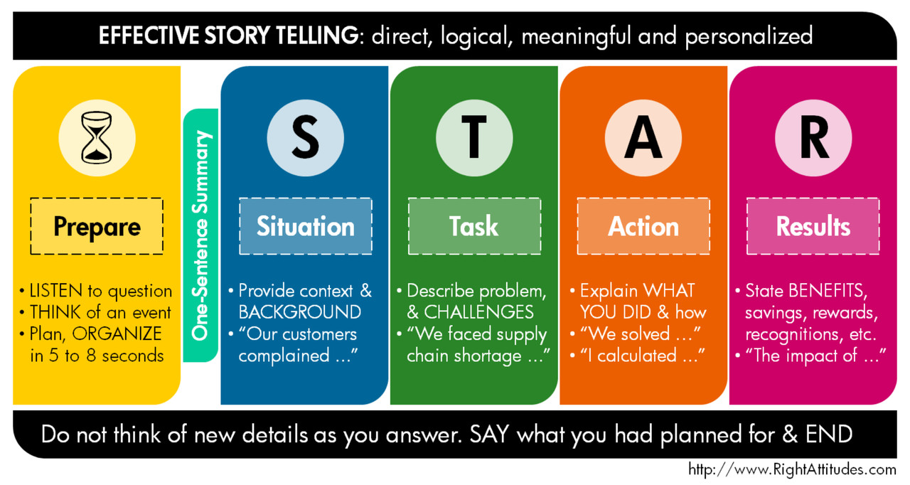
STAR Method

